Slide 1
Introduction to Framework
Raja

Slide 2
Big Data and Cloud Platforms
New Paradigm of Research => Data Science
Challenges in Data-oriented Research
Aim of Workshop

Slide 3
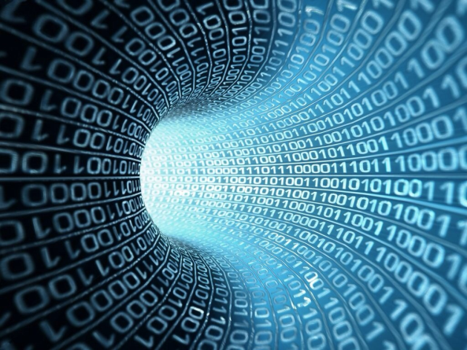
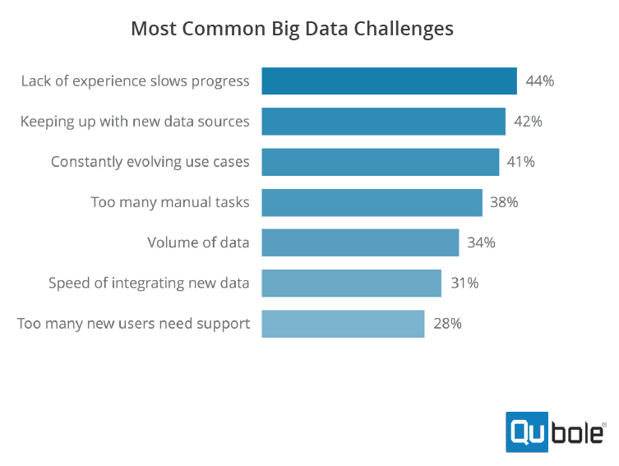
Big Data EveryWhere!
Lot of data collected and analyzed
Web data, e-commerce
Scientific projects
Commercial/Financial transactions
Social Network data
Health Information

Slide 4
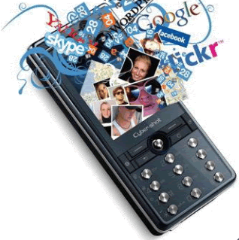
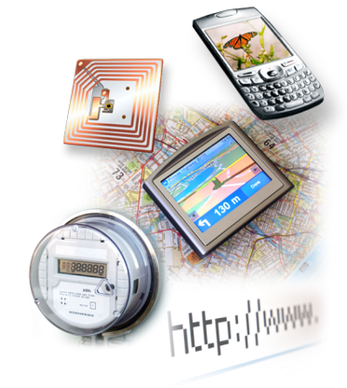

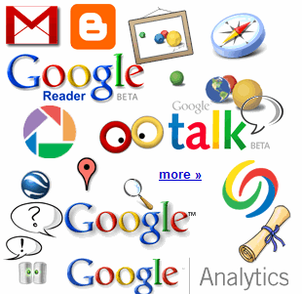

The Social Layer in an Instrumented Interconnected World
4.6 billion camera phones world wide
30 billion RFID tags today (1.3B in 2005)
12+ TBs of tweet data every day
100s of millions of GPS enabled devices sold annually
? TBs of data every day
25+ TBs of log data every day
2+ billion people on the Web by 2011
76 million smart meters in 2009… 200M by 2014
Notes:
Obviously, there are many other forms of data. Let’s start with the hottest topic associated with Big Data today: social networks. Twitter generates about 12 terabytes a day of tweet data – which is every single day. Now, keep in mind, these numbers are hard to keep accurate, so the point is that they’re big, right? So don’t fixate on the actual number because they change all the time and realize that even if these numbers are out of date by 2 years, it’s at a point where it’s too staggering to handle exclusively using traditional approaches.
+CLICK+
Facebook over a year ago was generating 25 terabytes of log data every day (Facebook log data reference: http://www.datacenterknowledge.com/archives/2009/04/17/a-look-inside-facebooks-data-center/
) and probably about 7 to 8 terabytes of data that goes up on the Internet.
+CLICK+
Google, who knows? Look at Google Plus, YouTube, Google Maps, and all that kind of stuff. So that’s the left hand of this chart – the social network layer.
+CLICK+
Now let’s get back to instrumentation: there are massive amounts of proliferated technologies that allow us to be more interconnected than in the history of the world – and it just isn’t P2P (people to people) interconnections, it’s M2M (machine to machine) as well. Again, with these numbers, who cares what the current number is, I try to keep them updated, but it’s the point that even if they are out of date, it’s almost unimaginable how large these numbers are. Over 4.6 billion camera phones that leverage built-in GPD to tag your location or your photos, purpose built GPS devices, smart metres. If you recall the bridge that collapsed in Minneapolis a number of years ago in the USA, it was rebuilt with smart sensors inside it that measure the contraction of the concrete based on weather conditions, ice build up, and so much more.
So I didn’t realise how true it was when Sam P launched Smart Planet: I thought it was a marketing play. But truly the world is more instrumented, interconnected, and intelligent than it’s ever been before and this capability allows us to address new problems and gain new insight never before thought possible and that’s what the Big Data opportunity is going to be all about!
4

Slide 5
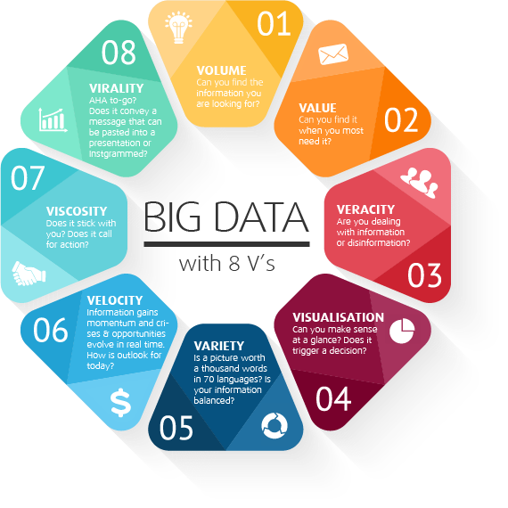
Characteristics of Big Data
Five Vs -
Volume – Exponential Increase in Size & Count
Velocity – Speed at which Data is Created,
Processed or Used
Variety – Multi-dimensionality, arrangement, format,…
Veracity – Integrity & Fidelity
Value – Worth
FAIR Data Principles
Findability
Availability
Interoperability
Reusability

Slide 6
Big Data Central to Our Future

Slide 7
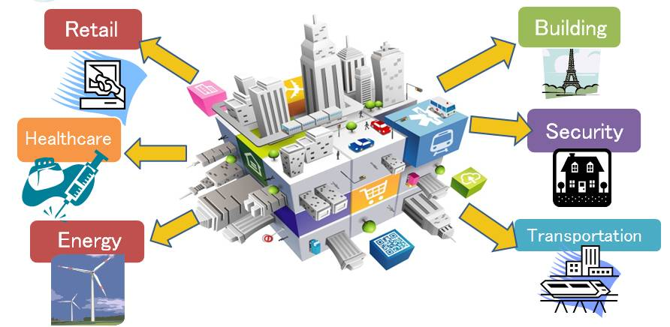
Cloud Environments
Real-time actionable insight
Massive monitoring
Observation
Performance and optimization
Proactive and predictive
Prescriptive and descriptive
Notes:
http://www.manufacturers.com.tw/trades_newsinfo.php?id=3355 Source of file

Slide 8



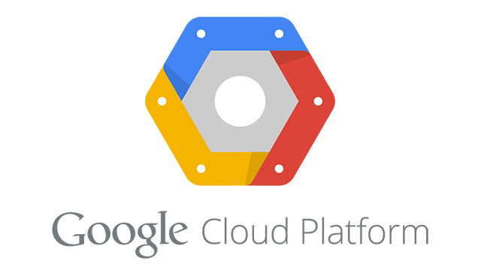
Types of Services
Software as a Service (SaaS)
Platform as a Service (PaaS)
Infrastructure as a Service (IaaS)
Storage as a Service
Cloud Computing =
Software as a Service
+ Platform as a Service
+ Infrastructure as a Service
+ Storage as a Service

Slide 9
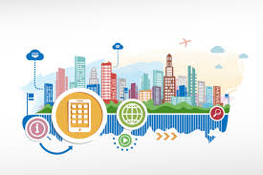
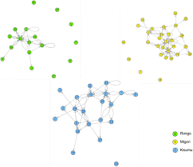
Convergence of Algorithms
Big Data
Social Media & Social Networking
Commerce; Medicine; …
Internet of Things; Satellite;
Drones
Service Orientation
Web, Workflows and Pipelines
Containers
Improved Accessibility & Availability
Open Source
Open Data
Novel Programming Paradigm
NoSQL;
Map Reduce/Spark; Storm
Socio-metric Network Analysis
Deep Learning
Block Chain
New Applications
Social Media
Smart Phones
Smart Cities
Smart Cars
Smart Medicines
Smart Science
Drones

Slide 10
Convergence of Technologies
Increasing Computational Power - Cheap COTS
sub 10nm; CPUs 32+ cores; 4K GPUs; Multi-TB RAMs; High Capacity Caches
Increasing Storage Capacity – Cheap COTS
Solid State Disks; Multi-TB Capacities
Increasing Networking Bandwidth
Internet: Fiber; New protocols;
Intranet: 100GB Ethernet; Wi-Fi; Bluetooth; IR; …
Intraconnects: InfiniBand; Fiber Channel; Ethernet
Clusters & Cloud Services
Scalable, On Demand, Elastic provisioning
Infrastructure, Software, Data, Platform

Slide 11
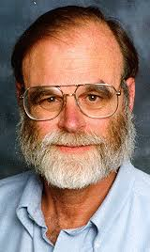
New Data + Algorithms + Technologies = Data Driven Science
New Model of Research: Collaborative scientific research involving multi-disciplinary teams from distributed organizations coming together to solve a common problem. Research is becoming socio-technical
Data-intensive: Distributed teams generating and harnessing significant amounts of data that require complex data mining, deep learning, semantic integration and analysis to discover and test new models and hypotheses
Jim Gray, Jan 2007: Fourth Paradigm – Data-intensive Scientific Discovery
“an evolving era in which an exaflood of observational data was
threatening to overwhelm scientists”
“data-intensive computing is fundamentally transforming
the practice of science”
1st: Experimental
2nd: Theoretical
3rd: Computational
4th: Data-driven

Slide 12
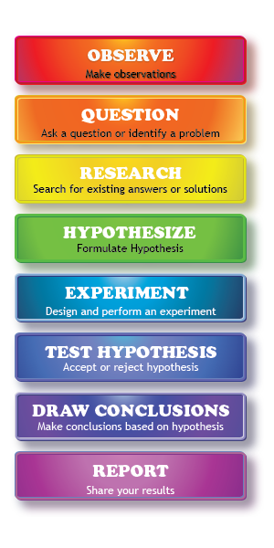
Science Discovery
Hypothesize
Observe
Test
From: https://sciencenotes.org/
steps-scientific-method/

Slide 13
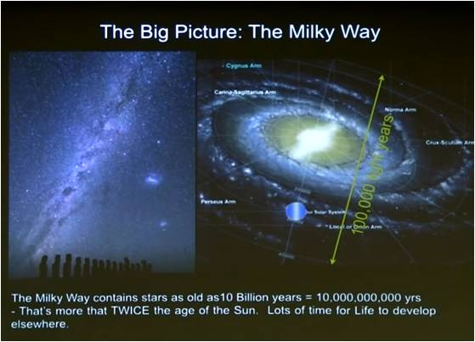
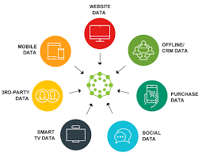
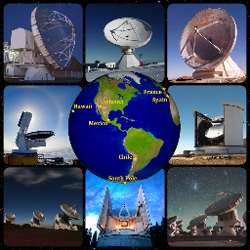

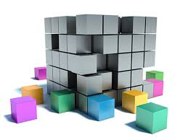
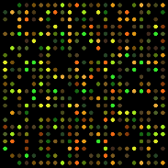
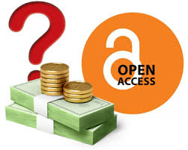






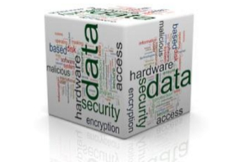

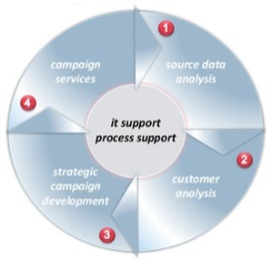

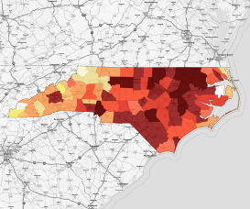
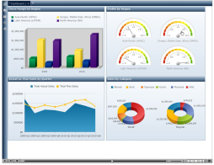
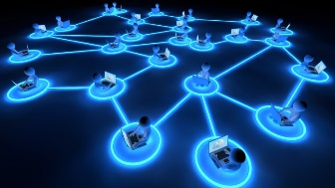
Fourth Paradigm Framework for Scientific Discovery Life Cycle
Pose Scientific
Question
Setup Instrumentation
Identify Data Sources
Discover
Data
Provision Storage
Gather
Observed/
Simulated Data
Publish
Environmental
Science
Astronomy
Social
Science
Data Science
Health
Science
Life Science
Prepare
Data
Curate
Provision Computation
Derive & Act
Map Distributions
View & Interpret
Analyze & Mine

Slide 14
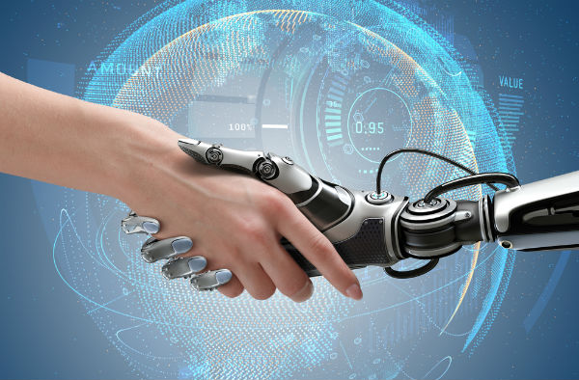
Sociotechnical Nature of Data
Data not objective; produced, used, interpreted, and reproduced in a social context
Sociotech perspective:
Social dynamics (e.g., personal, organizational, societal contexts) shape how data-intensive processes handled.
A key objective of researchers: contextualize data within a research context (relevance and affordances of data are relative to a context)
Data is not neutral: may reflect or even reinforce biases already existing around us (e.g. search algorithms)
Data that shape our lives are digital and mediated by digital technologies ; however technologies are not the only driver of how people put data into use. All levels of context matter
https://bpr.berkeley.edu
Notes:
2) in particular, one of the key objective of researchers should be to contextualize data within a research context; data in itself is not meaningful. Meaning, relevance and affordances of data are relative to a context: e.g. how does it help us understand the climate change, mindfulness of cell phone users, effectiveness of decision making in public administration, mutation of genes and etc.
3) Data is not neutral; it may reflect or even reinforce biases already existing around us. For example matchmaking process in online platforms (e.g. Airbnb or TaskRabbit) is susceptible to biases, such as social bias against certain races or genders in rating and review data, and this bias can be easily fed back into the recommendation and search algorithms. For these reasons, researchers need to attend to these extant biases or divergent ways of interpreting data.
4) data is brought to bear through a sociotechnical process. Data that shape our lives are increasingly digital and mediated by a broad diversity of digital technologies (e.g., fitness activity tracking or social media); these technologies are carrier of data; and it is almost impossible to separate data from it digital carriers. However these technologies are not the only driver of how people put data into use. As noted above, all levels of context closely impact the way data interact with technology (e.g., relevance of Fitbit data is greatly dependent on already existing conditions of individuals and their current motivations to lose weight and etc).

Slide 15
Data Science
Computer
Science
Information
Science
Social
Science
Math, Logic,
Statistics, OR, …
Domain Sciences
Engineering
Economics
Medical
Legal
…

Slide 16
Challenges to Data-driven Scientific Discovery
Findability - Distributed data collections
Autonomous Administrations
Protocol differences
Metadata
Technology Evolution
Protocol/API changes
Technology obsolescence
Massive scale – Big Data & Large Resources
Size, Numbers, Speed, Types, Formats, Time-critical
Users, Resources, Applications, Data
Availability & Accessibility
Loss, Corruption, Broken Links, Copyright, Access Control, Dark Data
Increasing lifespan for data
Long-term curation
Context capture
Reusability
Reproducible results
Integrity & provenance
Interoperability
Intra and Inter domain repurposing
FAIR Data Principles
Findable
Accessible
Interoperable
Reusable
Five V’s of Big Data
Volume
Velocity
Variety
Veracity
Value

Slide 17
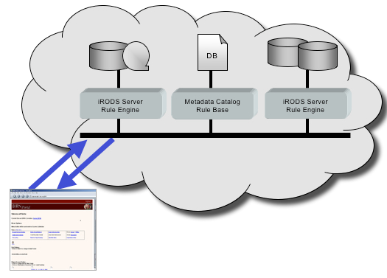
Solution: The DFC Approach
Federate
Deal with distributed data collections
Deal with distributed computing
Deal with distributed collaboration
Virtualize
Deal with evolution
Deal with availability
Deal with interoperability
Deal with lifespan
Automate
Deal with Technology changes
Deal with scale
Deal with management
Deal with reusability
Ideas developed & improved as part of an NSF funded project between 2011-2017
Datanet Federation Consortium

Slide 18
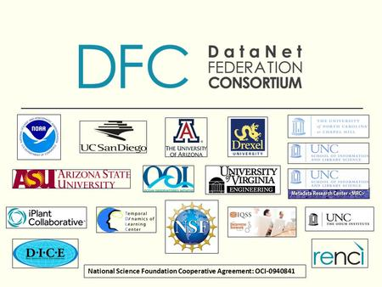

Slide 19
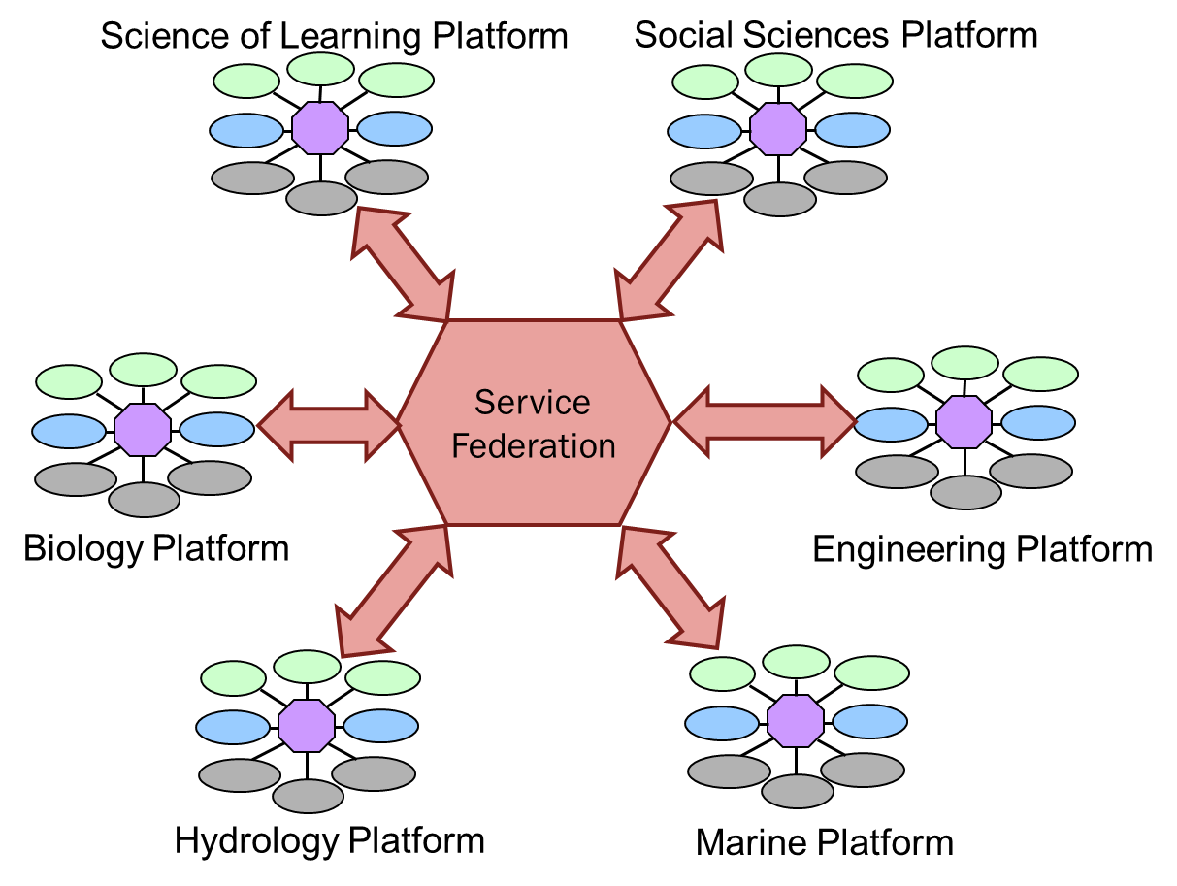
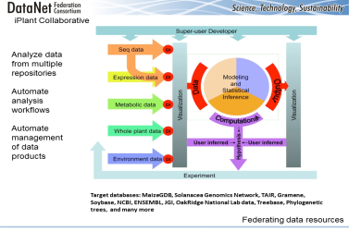
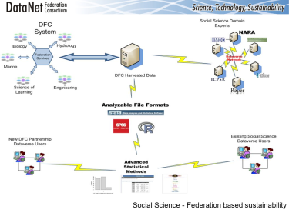
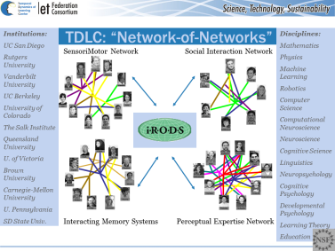
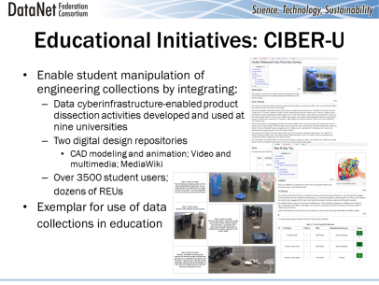
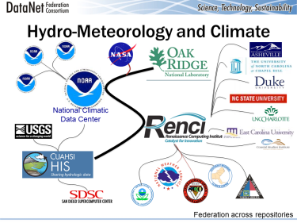
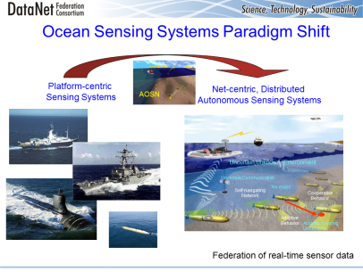
Datanet Federation Consortium

Slide 20
Aim of the Workshop
This workshop builds upon the model of DFC
Impart to emerging scientists the lessons learned in DFC
Provide a pathway to perform science in collaboration
Motivate to capture context for information and computation
Learn to make your research reproducible and reusable
How to conform to FAIR Principles
Bring out the socio-technical nature of emerging research paradigm
Empower scientists to navigate the fourth paradigm
Do this in a hands-on fashion
By using tools and technologies of the current day
But providing insights into how to translate to those in the future
Virtualize Federate Automate

Slide 21
Workshop: Virtualize
Data Virtualization & Common Name Space
iRODS
Keyword & Tags
Compute Virtualization
Jet Stream
Cloud Computing: AWS
Docker, Singularity
Contextual Metadata
Ontologies: Dataverse
Science Portals: CyVerse, Hydroshare, Dataverse

Slide 22
Workshop: Federate
Federating Distributed Data Sources
iRODS
Cloud Storage
Federated Computing
Cloud Computing & HPC
Atmosphere
Distributed Metadata
Elastic Search
Distributed Platforms
AWS, XSEDE
Federated Research
Collaboration Tools
Coordination Tools

Slide 23
Workshop: Automate
Server-side Workflows
DE
Hydroshare
SnameMake, Makeflow
Collaborative Desktop Workflows
KNIME
Rstudio/Rshiny
Jupyter
Automation of Data Management & Ingestion Pipelines
iRODS

Slide 24
Deep Learning

Slide 25
What is Deep Learning?
In the words of Andrew Ng, founder of Google Brain:
“When you hear the term deep learning, just think of a large deep neural net. Deep refers to the number of layers typically and so this kind of the popular term that’s been adopted in the press. I think of them as deep neural networks generally.” – 2016
“Deep learning methods aim at learning feature hierarchies with features from higher levels of the hierarchy formed by the composition of lower level features. Automatically learning features at multiple levels of abstraction allow a system to learn complex functions mapping the input to the output directly from data, without depending completely on human-crafted features” – 2009

Slide 26
Deep Learning vs ANN
Deep Learning
Performance
Traditional ANN
Size of Data
(from Ng)

Slide 27

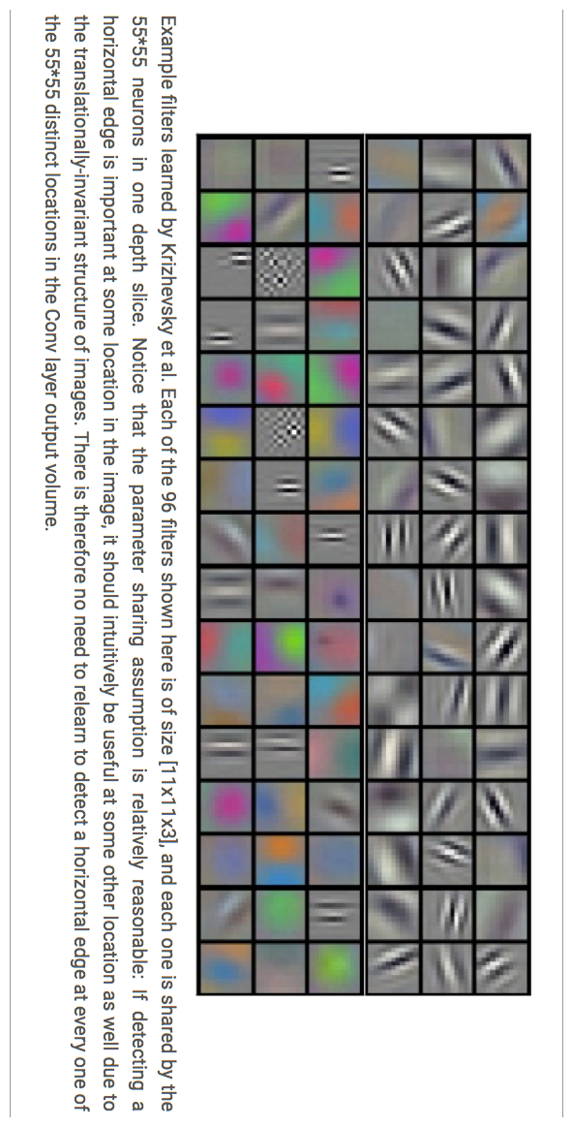


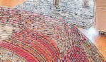




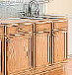






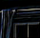

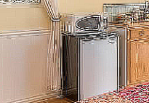
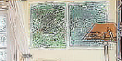
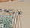
Feature Selection
Deep learning has an automatic multi stage feature learning process that learns rich hierarchical representations (i.e. features).
Low Level Features
Mid Level Features
High Level Features
Trainable Classifier
Output
(e.g. outdoor, indoor)

Slide 28
Concept of Convolution
Feature detection through filters
Y= 4*2 + 2*1 +3*1 + 5 * 2
4 | 2 | 1 | 2
3 | 5 | 6 | 2
3 | 4 | 3 | 1
6 | 2 | 1 | 4
2 | 1
1 | 2
23 | 22 | 14
22 | 26 | 19
20 | 15 | 16
X
=

Slide 29
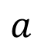
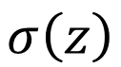
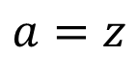
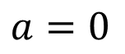
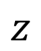
Concept of Rectification
ReLU: Rectified Linear Units
Idea is to remove negative values
[Xavier Glorot, AISTATS’11]

Slide 30
Concept of Pooling
Down-sampling of the convolution output
Reduce size for next step (Max or Average)

Slide 31
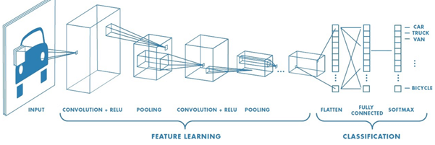
Deep Learning Network
From guru99.com

Slide 32
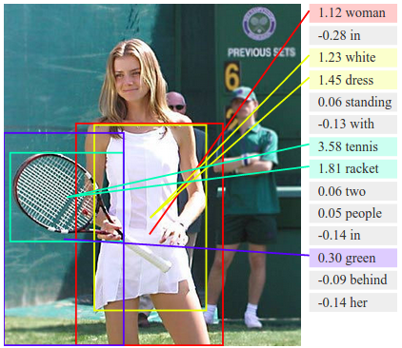
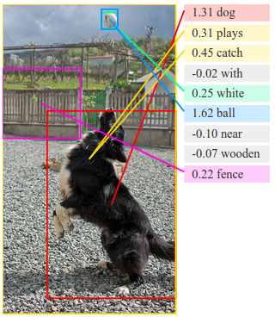
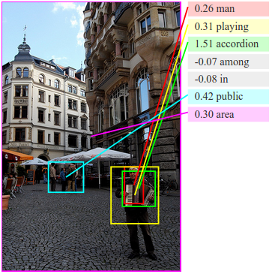
Examples of DL
Visual-Semantic Alignments
From: https://cs.stanford.edu/people/karpathy/deepimagesent/

Slide 33
Questions?

